Slide 1
CITY CARE Smart City Complaint Management System
Presented By:Christin Benny
Reg no : MGP24MCA-2030
Guide : Mr. Jacob Zachariah
Department : MCA
Saintgits College of Engineering (Autonomous), Kottayam

Slide 2
ABSTRACT
This project proposes a Smart City Complaint Management System that automatically categorizes citizen complaints using NLP and Machine Learning. It improves routing accuracy, reduces delays, and enables real-time complaint tracking for efficient municipal governance.

Slide 3
Problem Statement
Manual sorting of complaints
Delay in complaint forwarding
Misrouting to incorrect departments
Poor citizen satisfaction
Lack of real-time tracking

Slide 4
Complaint Categories
The system classifies complaints into the following categories:
Road & Infrastructure
Water Supply
Electricity & Streetlights
Garbage & Sanitation
Public Safety

Slide 5
Work Done After Review 1
Finalized complaint categories.
Identified important keywords for each category.
Prepared dataset using:
Manually created complaints
Other relevant sources
Ensured dataset covers different public vocabulary.
Trained ML model for complaint classification.
Designed UI using Figma.

Slide 6
UI & Interface Development
User Registration & Login
Complaint Submission Form
Complaint Status Tracking
Department Admin Dashboard
Admin Dashboard
Visual Reports & Charts

Slide 7
Core Logic & Backend
Text preprocessing Feature extraction
ML model inference
Department prediction
Status updates & remarks
Trend analysis & reporting

Slide 8
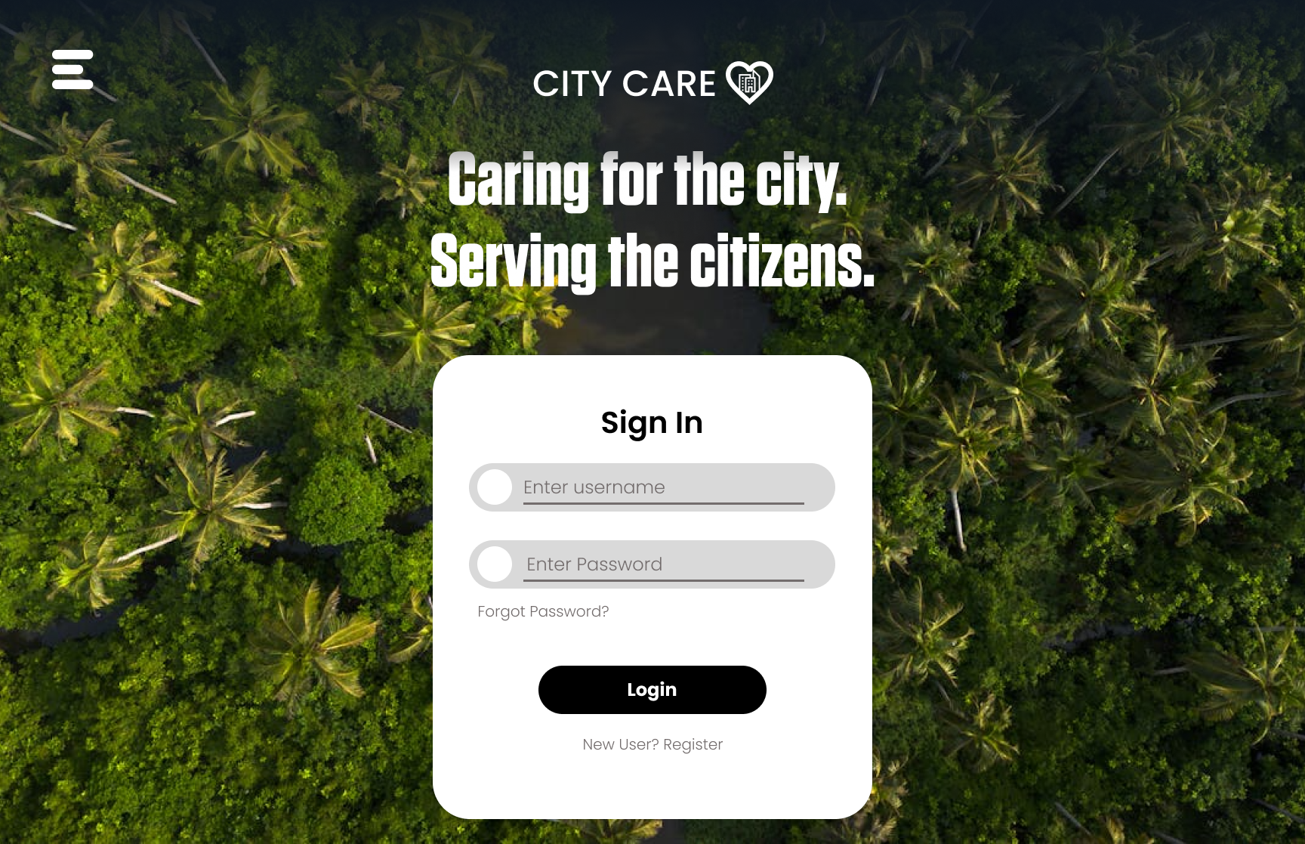
UI Design

Slide 9
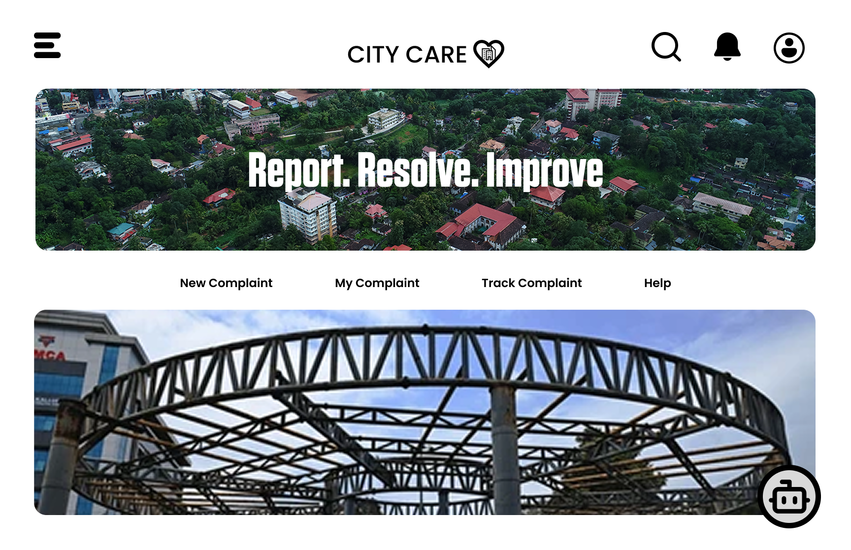
UI Design

Slide 10
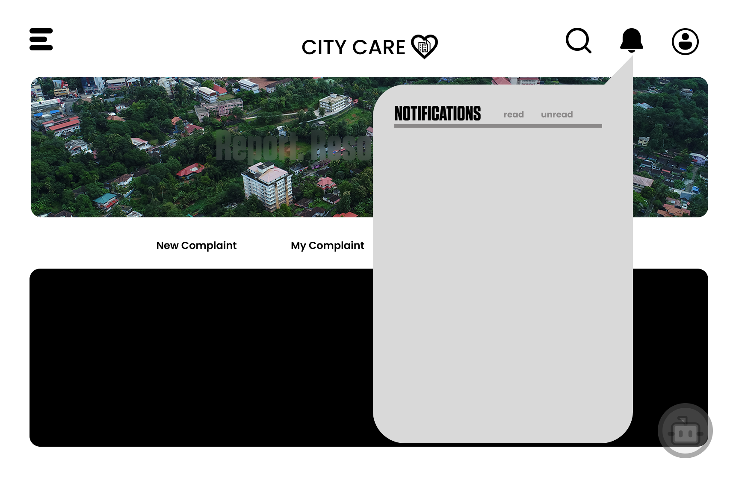
UI Design

Slide 11
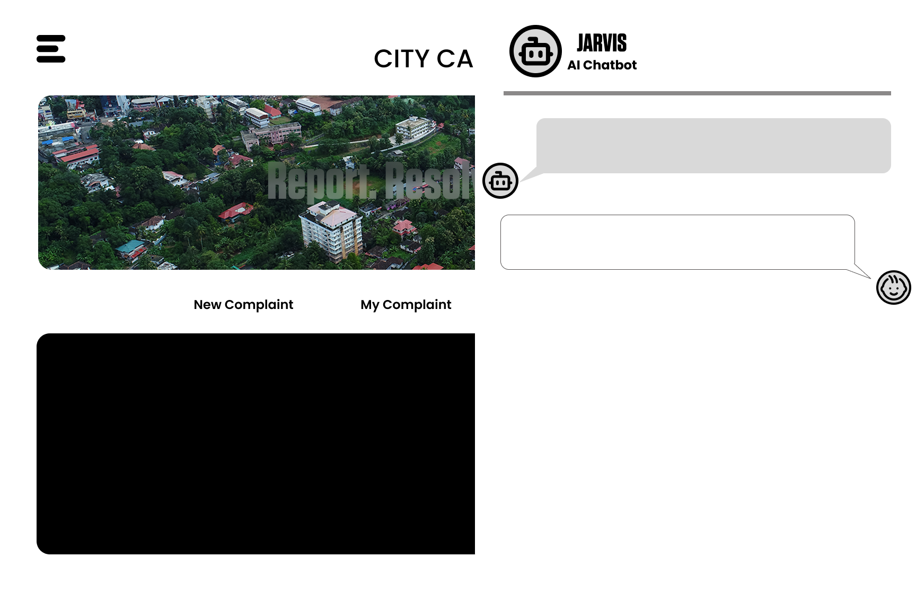
UI Design

Slide 12
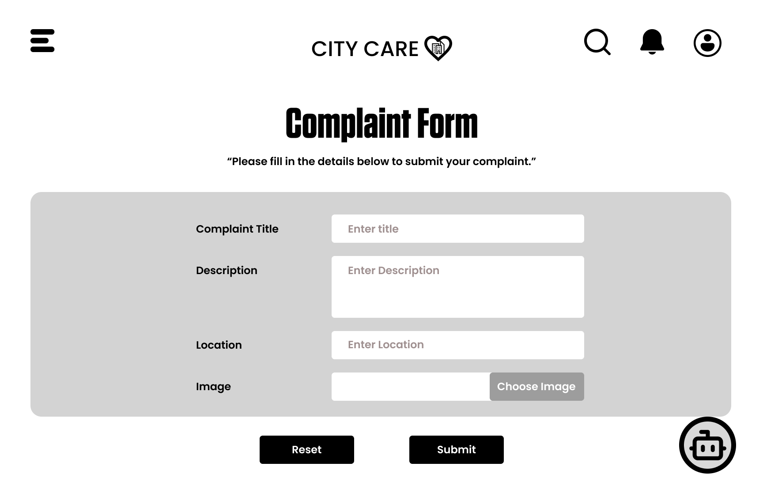
UI Design

Slide 13
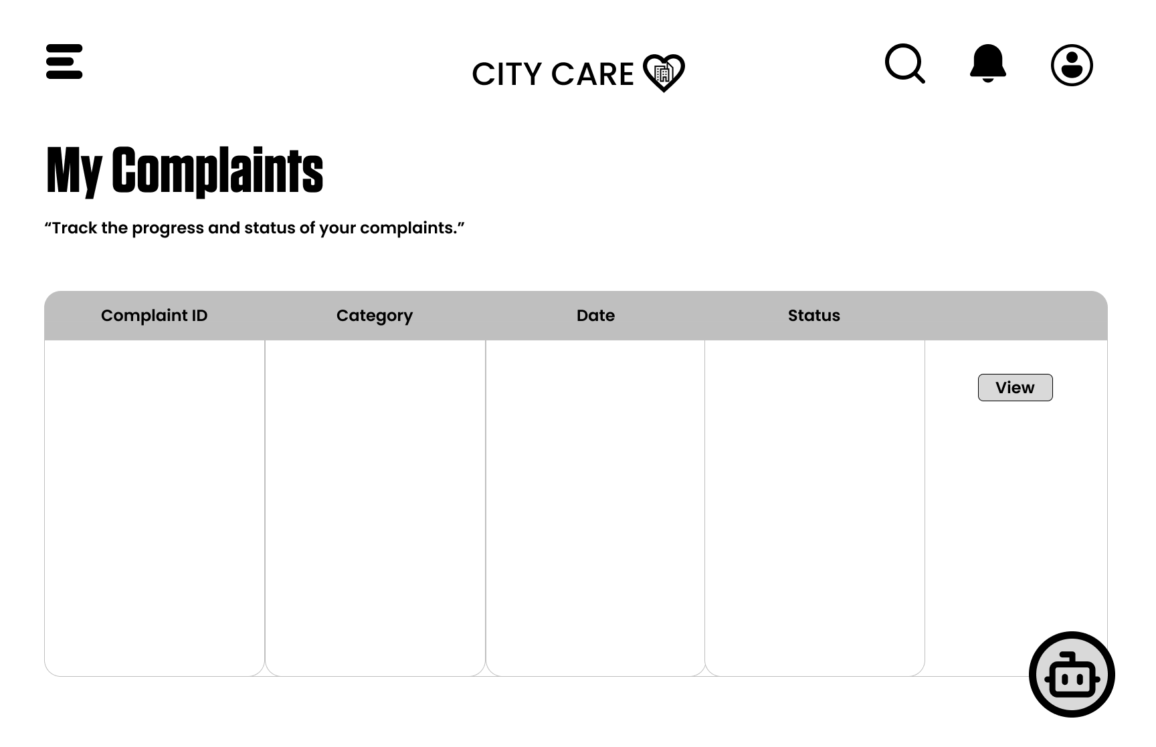
UI Design

Slide 14
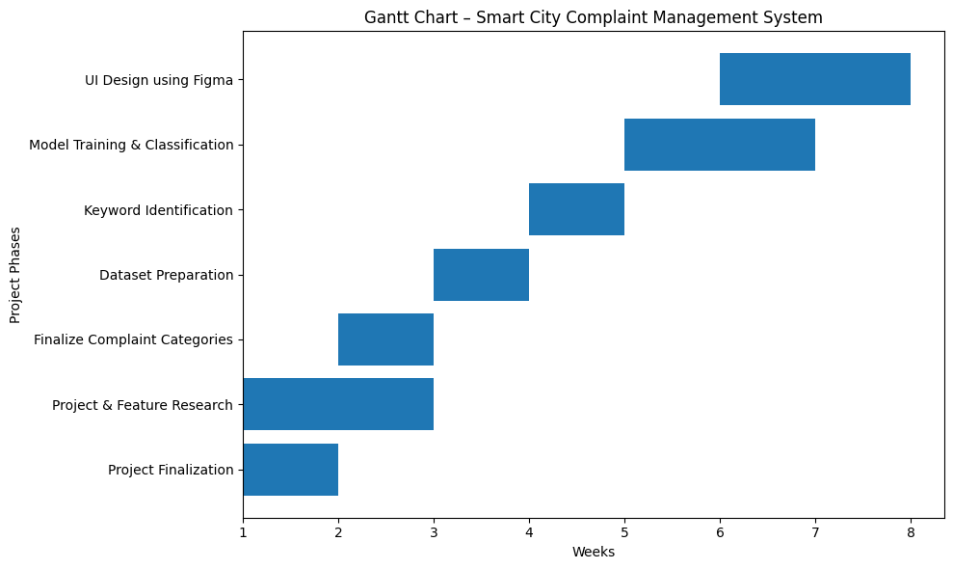
GANTT CHART

